Slide 1
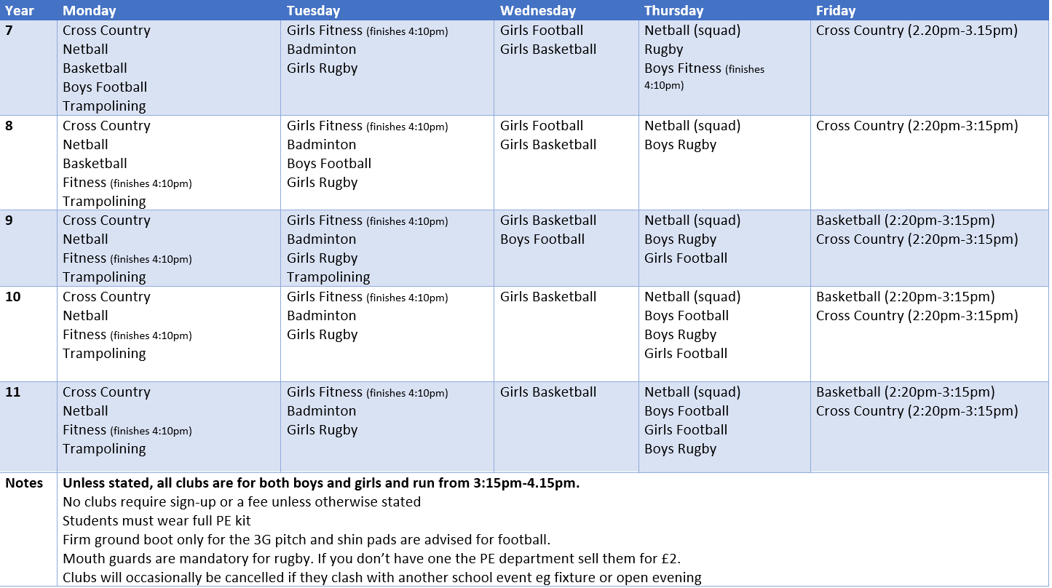





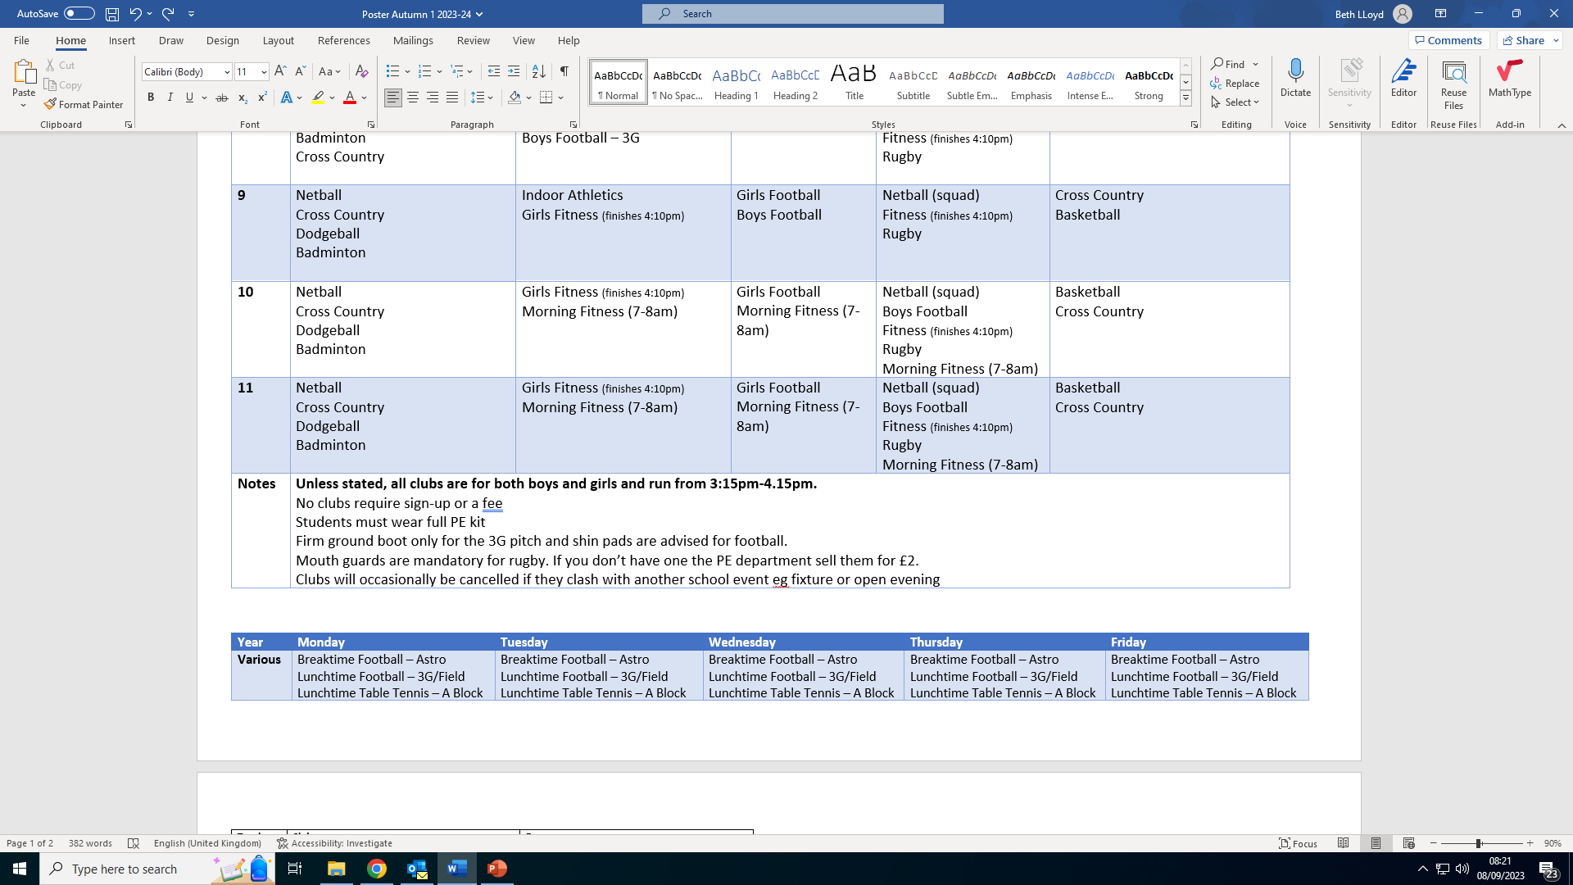
Physical Education Clubs – Autumn Term
After/Before School Clubs
Partner Providers:
Football Club
Netball Club
Cross Country
Athletics Club
Self Defence Club
Basketball Club
Break and Lunchtime Clubs

