Slide 1

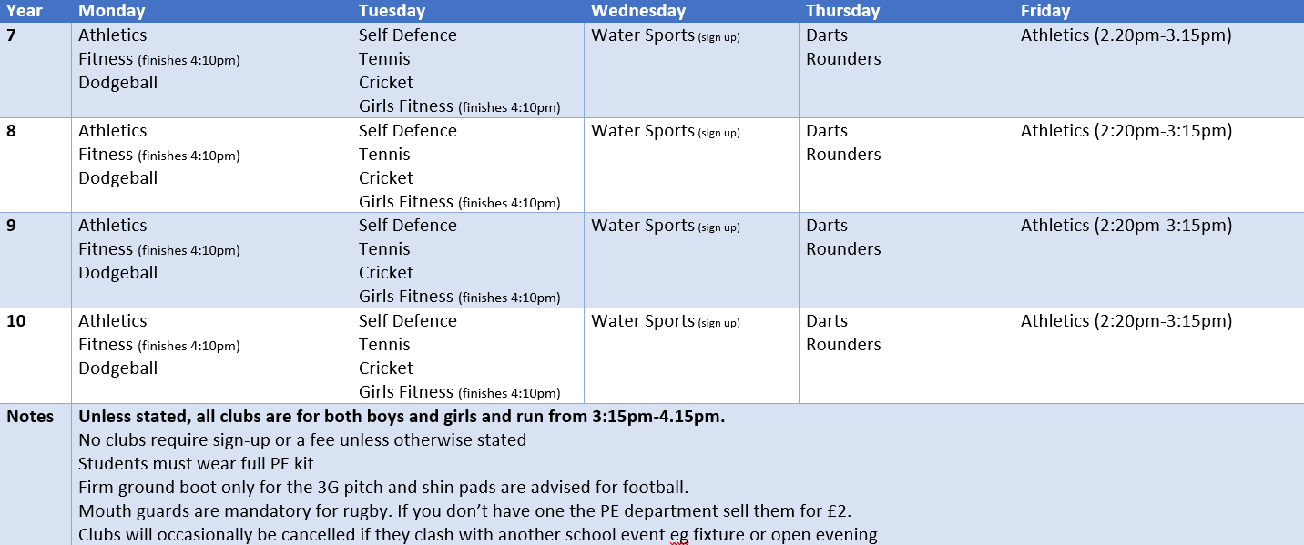



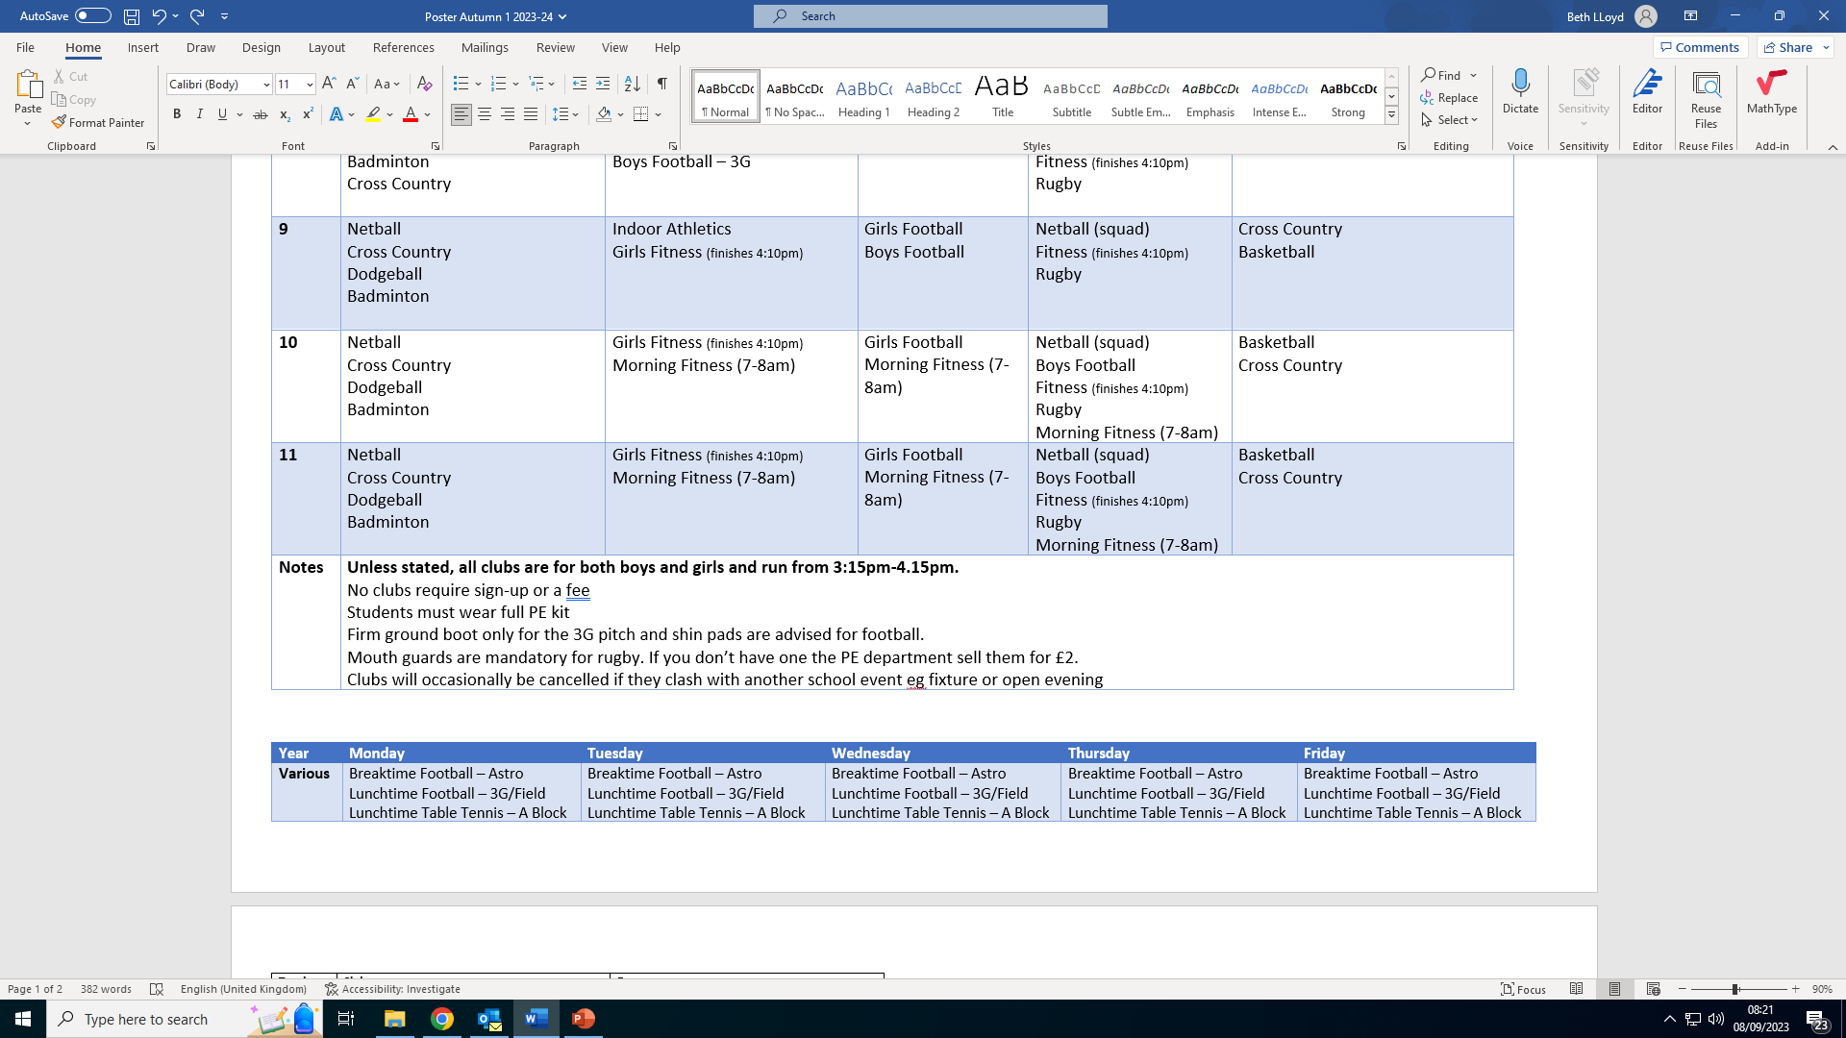

Physical Education Clubs Summer Term
Partner Providers:
Football Club
After/Before School Clubs:
Netball + Basketball Club
Cross Country +
Athletics Club
Kick Boxing Club
Break and Lunchtime Clubs:
Advance Performance

