Slide 1




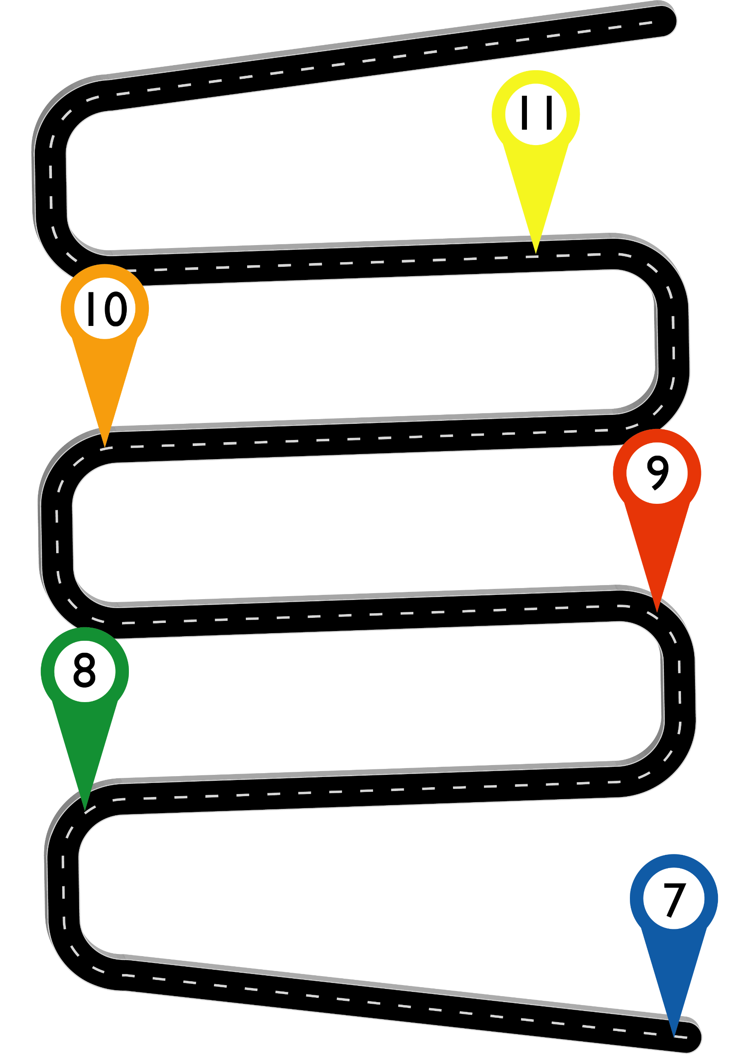










Careers Education Learning Journey
Apprenticeship or training?
Gatsby Benchmarks:
Stable careers programme
Learning from Career and Labour Market Information
Addressing the needs of each pupil
Linking curriculum learning to careers
Encounters with employers and employees
Experiences of workplaces
Encounters with further and higher education
Personal guidance
College?
Sixth Form?
Autumn 1: Post-16 pathways and choices unit
Goal setting – career progression
Post-16 plans and applications
Personal finances – post 16
Planning your finances for the future
CDI Framework:
Self-awareness (1)
Self-determination (2)
Self-improvement as a learner (3)
Exploring careers and career development (4)
Investigating work and working life (5)
Understanding business and industry (6)
Investigating jobs and LMI (7)
Valuing equality, diversity and inclusion (8)
Learning about safe working practices and environments (9)
Making the most of CEIAG (10)
Preparing for employability (11)
Showing initiative and enterprise (12)
Developing personal financial capability (13)
Identifying choices and opportunities (14)
Planning and deciding (15)
Handling applications and interviews (16)
Managing changes and transitions (17)
Spring 1: Work experience preparation unit
Employability skills
CV writing
Interview skills
‘Health and safety’ in the workplace
Career identity and online profile
Y10 Work Experience Week (Summer 2)
Summer 2: Career Management unit
Employability skills
Team work
Different types and patterns of work
Career identify and progression
Equality of opportunity, discrimination and rights
Preparing for employment at 14+
Y9 Enterprise
Day (Spring 1)
Objectives:
Self-Development (helping students to understand themselves, recognise their potential and how they can shape their future)
Career Exploration (helping students to investigate opportunities in learning and work and how to use information effectively)
Career Management (helping students to plan, make decisions and develop a broad range of skills enabling them to manage their own careers and prepare themselves for employment and lifelong learning)
Spring 1: Financial Education unit
Managing money and debt
Recognising money habits
Financial security
Value for money- purchasing
Impact of technology on money
Summer 2: Financial Education unit
Introduction to budgeting
Banking and budgeting basics
Safe and sensible spending
Building financial independence
Money and employment
Autumn 1: Aspirations, goals and dreams unit
Transition to secondary school
Personal qualities and skills
‘All About Me’ project
T5 Award
Spring 1: Introduction to Careers unit
Routes into different careers
Exploring big businesses
Professional areas in businesses
Working locally
Linking values to career choices
Junior School

